Slide 1



CKI Abbreviations and
TLAs (Three Letter Acronyms)
Capital District Circle K International
Membership Development & Education Committee
August 2014

Slide 2
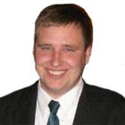
ADA
Assistant District Administrator
Helps the District Administrator advise the District Board
The CDCKI ADA is Derek Dupuis

Slide 3
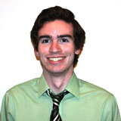
CBR
Club Building & Revitalization
This is a committee responsible for helping clubs reactivate and charter throughout the district.
This year, the CDCKI CBR Committee is led by Matt Johnson.

Slide 4
CDCKI
Capital District Circle K International
The mascot for the Capital District is Krabby the crab!

Slide 5
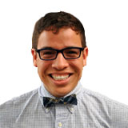
Con-Con
Conventions and Conferences
A committee responsible for planning and executing major district events like DCON and FMR.
The CDCKI Con-Con committee chair is Richard Gallo.

Slide 6
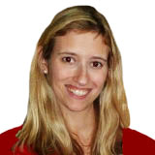
DA
District Administrator
Advises the District Board as they make decisions and lead the district.
The CDCKI DA is Jen Wolff.

Slide 7

DCON
District Convention
A 3-day event during which members from across the district come together to celebrate all of their hard work during the service year.
This year’s CDCKI DCON will be held February 19-22, 2015 in Fairfax, Virginia.
Last year’s theme was The Wonderful World of Service (Disney!)

Slide 8
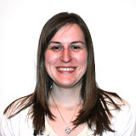
DLSSP
District Large Scale Service Project
An event which brings members from across the district to do service together.
The CDCKI Service committee (led by Kelly Griffith) is hard at work planning DLSSP for the upcoming semester!

Slide 9
DOTC
District Officer Training Conference
Where newly elected District Officers learn how to be effective in their positions.
The District Board uses the weekend to set goals for the district and make plans for events for the upcoming year.

Slide 10
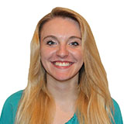
DST
District Secretary Treasurer
Gathers important information about the clubs in the district from club secretaries and treasurers.
Also exists as a resource for clubs.
The CDCKI DST is Nicole Tardif

Slide 11

FMR
Fall Membership Rally
A 2-day event during which members from across the district can meet new people and learn about the exciting opportunities CDCKI has to offer.
This year, CDCKI’s FMR will be held October 24-25, 2014 in Front Royal, Virginia.
Last year’s theme was Mario Kart!

Slide 12
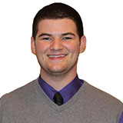
GATC
Governors/Administrators Training Conference
CKI Governors and Administrators from across the world come together to make plans for the upcoming year and learn useful strategies for how to best serve their districts.
This year, our DA attended with our Governor, Ben Romano.

Slide 13

ICON
International Convention
Like DCON, but on a much bigger scale. Instead of just clubs from one district, clubs from across the world are invited to celebrate being a part of such an awesome organization.
This past year’s ICON was held in June in Nashville, TN.
Next year’s ICON will be held in Indianapolis, IN.

Slide 14
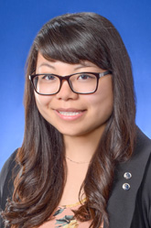
IP
International President
Elected at ICON by delegates from around the world, the IP is the student leader for the international organization.
Similar to a club president and a district Governor, but at the International level.
At this year’s ICON, Kathy Le was elected IP.

Slide 15

K1D
Kiwanis One Day
A global initiative meant to encourage all members of the K Family from all around the world to come together in service.
In 2015, Kiwanis One Day will held on April 11th.

Slide 16

KFW
Kiwanis Family Weekend
Within the Capital District, the district boards for Kiwanis, CKI, and Key Club come together for a weekend to discuss goals for the greater Capital District Kiwanis family.

Slide 17

LA
Leadership Academy
Held every summer, this 6-day event focuses on servant leadership and its value in the real world.
It is open to all CKI members and is held in Indianapolis, IN.
This past year, it was held July 27-August 1, 2014

Slide 18

LSSP
Large Scale Service Project
Usually held prior to ICON, this year’s LSSP was held in conjunction with ICON.
It gives members a chance to do service with other members from around the world.

Slide 19
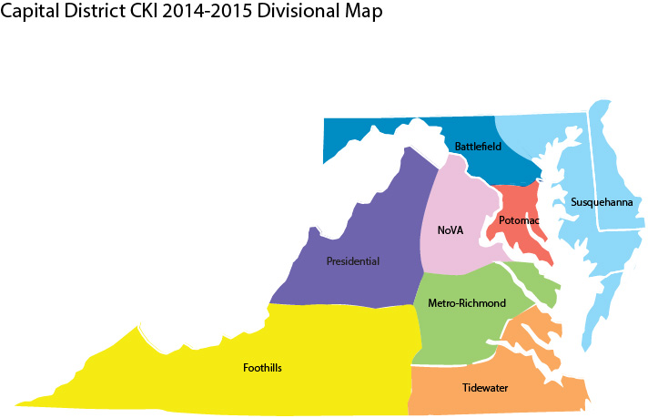
LTG
Lieutenant Governor
Serves the district and, more specifically, the clubs in their specific division.
CDCKI has 8 LTGs serving the 8 divisions.

Slide 20
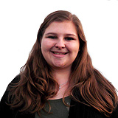
MDE
Membership Development & Education
This committee works with the other committees to create and revise the resources available for members of the Capital District.
This year’s MDE committee chair is Caitlin Francis.

Slide 21

MOM
Member of the Month
Every month, each club has an opportunity to recognize a member who goes above and beyond in service to their club and local community.

Slide 22

MRF
Monthly Report Form
MRFs are to be filled out monthly by club secretaries and members of the district board to keep all of the level of CKI aware of how clubs and members are doing.

Slide 23

PCM
Presidents Council Meeting
A great way for presidents in a division to communicate with each other and their LTG about what is happening in their clubs.

Slide 24

SLP
Service Leadership Program
Kiwanis International wants to empower people of all ages to discover the values of service.
SLP refers to the other branches of the K Family: K Kids, Builders Club, Key Club, Circle K, and Aktion Club.

Slide 25

SOTC
Spring Officer Training Conference
A 2-day event providing new club board members with education and connection opportunities.
Next year’s SOTC will be held March 27-28, 2015.

Slide 26

TFG
Tomorrow Fund Grant
The Tomorrow Fund is an endowed fund for Circle K International held within the Kiwanis International Foundation.
If your club has a project it would love to see happen, but you need funds to help get it off the ground, the TFG could be a great resource.
Applications are due every year on December 1st.

Slide 27
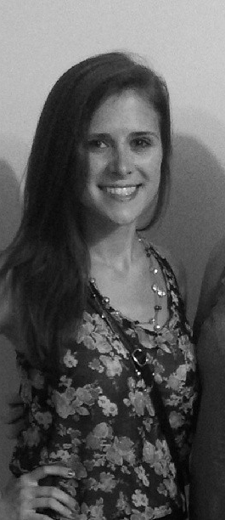
TKD
Total K Day
A day meant to unite all of the branches of the Kiwanis family in service.
CDCKI is in the process of planning an exciting TKD experience with the help of the Kiwanis Family Relations Committee (led by Heather Howell).

Slide 28
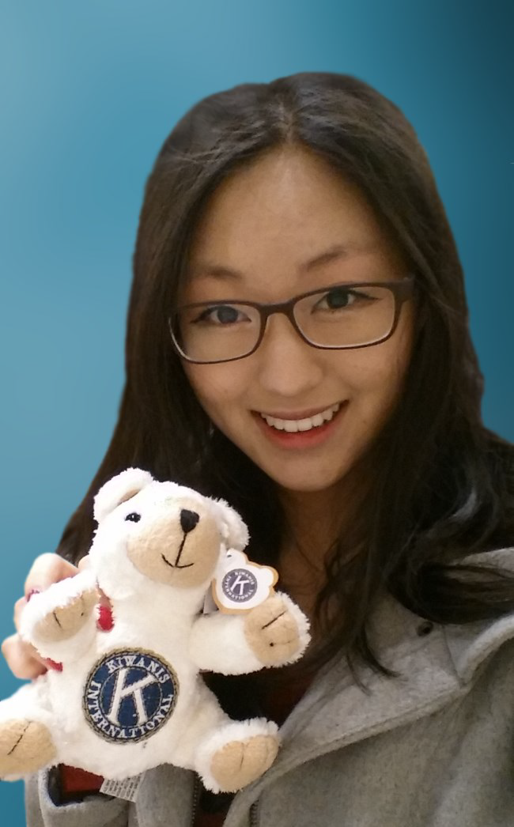
VP
Vice President
At the international level, the VP supports the IP and produces a weekly newsletter to be distributed to all members.
Clara Oh was elected International VP at this year’s ICON in Nashville.

